Slide 1

Vue introduction
The progressive framework

Slide 2
Agenda
What is SPA?
What is Vue?
The Vue instance
The component system
The rest of Vue ecosystem
Live code
Opinionated comparison

Slide 3
What is SPA?
The revolution of SPA

Slide 4







The ‘old’ way
Client side
Multiple Page Application
Request
Response
Server side
Presentational Layer
Big payload (compare to SPA)
Browser refreshing
Duplicated content
Controller
Views
Coupling
Service Layer
Business Layer
Heavy transactions
Jarring, bad UX
Bad practice
Slowdown the development
Data Layer
Data
Source

Slide 5


The revolution of AJAX (Asynchronous JavaScript and XML)
XMLHttpRequest (XHR) API
Update
+

Slide 6

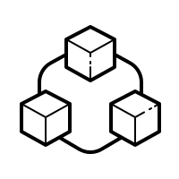

The ‘SPA’ way
Client side
Views
Single Page Application
AJAX
JSON, XML…
Views generating process is handled at frontend
Server side
Single HTML initialize only once
Dynamically & asynchronously updating DOM
Communicating via JSON data
Presentational Layer
Controller
JSON, XML…
Service Layer
Business Layer
Decouple development process
Lighter payload for later transactions
Without Browser refreshing
Increase
codebase reusability
Data Layer
Data
Source

Slide 7







SPA is very popular
Give better UX for end users
Beneficial to PWA and mobile development
Easier for developers

Slide 8
What is Vue?
Brief history
Design philosophy
Architect pattern

Slide 9



Brief history
Vue in French
=
View in English
First commit was on July 2013

Slide 10
Design philosophy
Declarative
Rendering
Component
System
Client-side
Routing
State
Management
Build
System

Slide 11
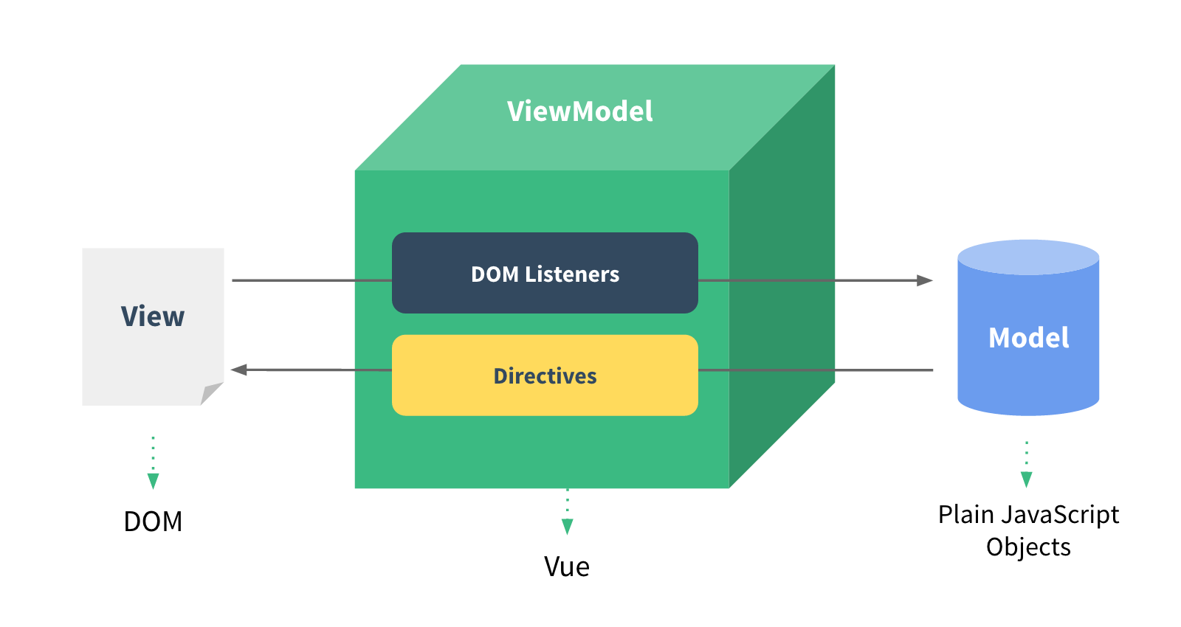
Architecture pattern

Slide 12

The declarative rendering
State
Rendered UI
Vue instance
Declarative
How the state should be on the UI
Imperative
What are the step to transform the state to the UI
data: { text: ‘Hello World’ }
<div id=‘demo’> {{text}} </div>
const newElement = document.getElementById(‘demo’)
newElement.textContent = ‘Hello World’

Slide 13
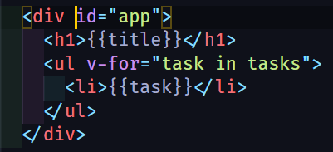
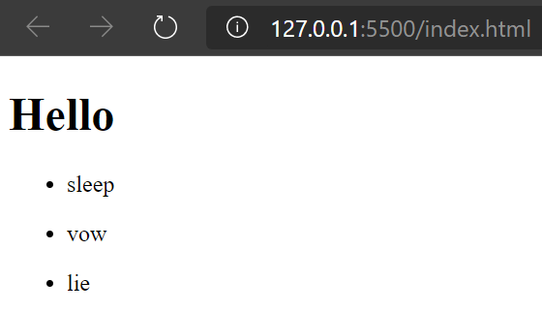
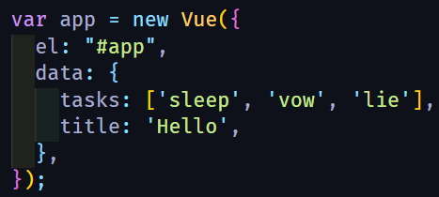
Interpolate template
Hook up
Options

Slide 14
The Vue instance
Vue options
Vue directives
Instance lifecycle

Slide 15
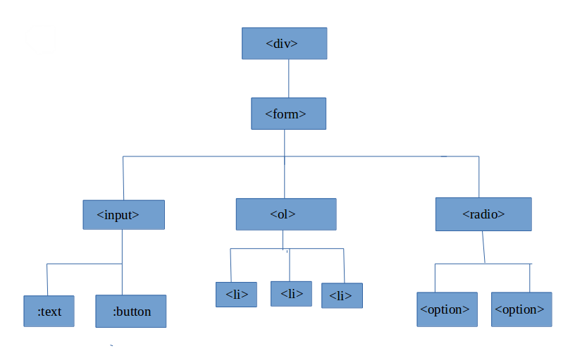
The vue instance
beforeUpdate
Vue directives
beforeCreate
created
updated
HTML Tree
beforeMount
beforeDestroy
mounted
destroyed
Life cycle
Vue instance
{Options}
#el
computed
template
data
methods

Slide 16
Vue options

Slide 17
#el, template, data
HTML
#el: Mount Vue instance with DOM element
via CSS selector
template: Define HTML markup for Vue instance
within a string
data: A data object or a function return object for Vue component, it’s reactive

Slide 18
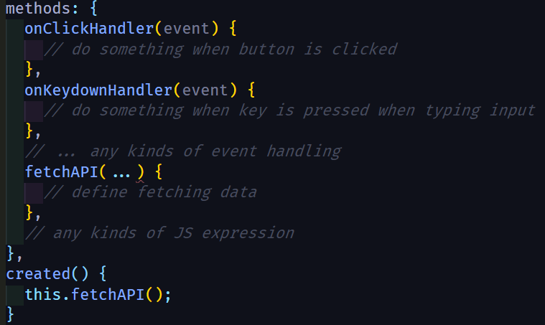
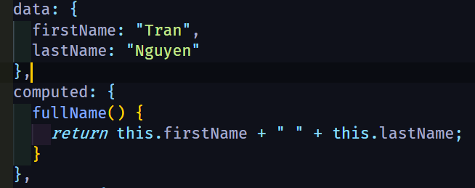
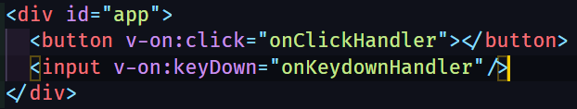
Method, computed
views
data
?
computed
events
methods

Slide 19
Vue directives

Slide 20
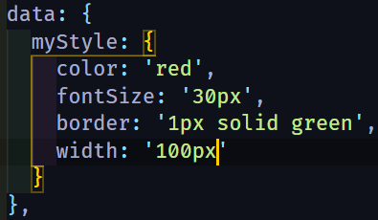



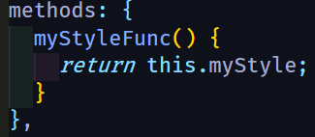
Data binding
data
Template element’s attributes
props
computed
methods
v-bind
…
bind
bind

Slide 21



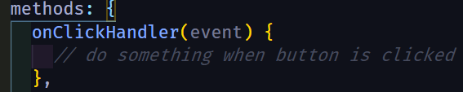
Event handling
v-on
methods
bind

Slide 22
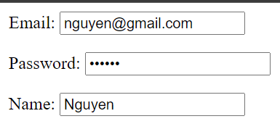
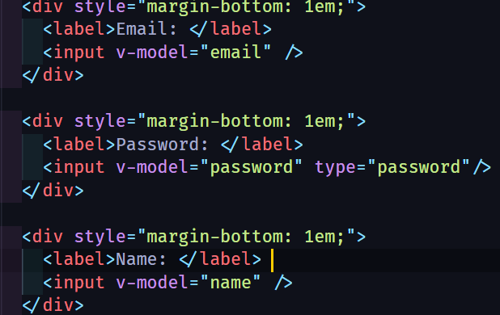
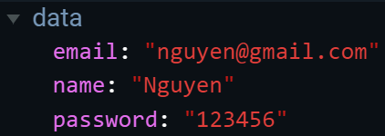
Form input binding
v-on:input
v-model
Input value
v-bind:value
v-model

Slide 23
Notes
v-on, v-bind shortcut
v-on:click
@click
v-bind:style
:style
specifier
<directiveName>:<argument>.<specifier> = "<expression>"
Ex:
v-on:click.keyup
v-model.lazy
Specifier indicates the directive should be bound in special way

Slide 24
Conditional rendering
v-if = “conditional expression”
v-else-if = “conditional expression”
v-else
v-show = “conditional expression”
Toggle CSS property display
Toggle real rendering process

Slide 25
List rendering
v-for = “(value, key, index) in object”
v-for = “(item, index) in array”
<ul v-for = “(item, index) in array” :key=“item.uniqueId”>
// below block of code will have access to item, index
<li>
…
</li>
</ul>

Slide 26
Instance lifecycle

Slide 27
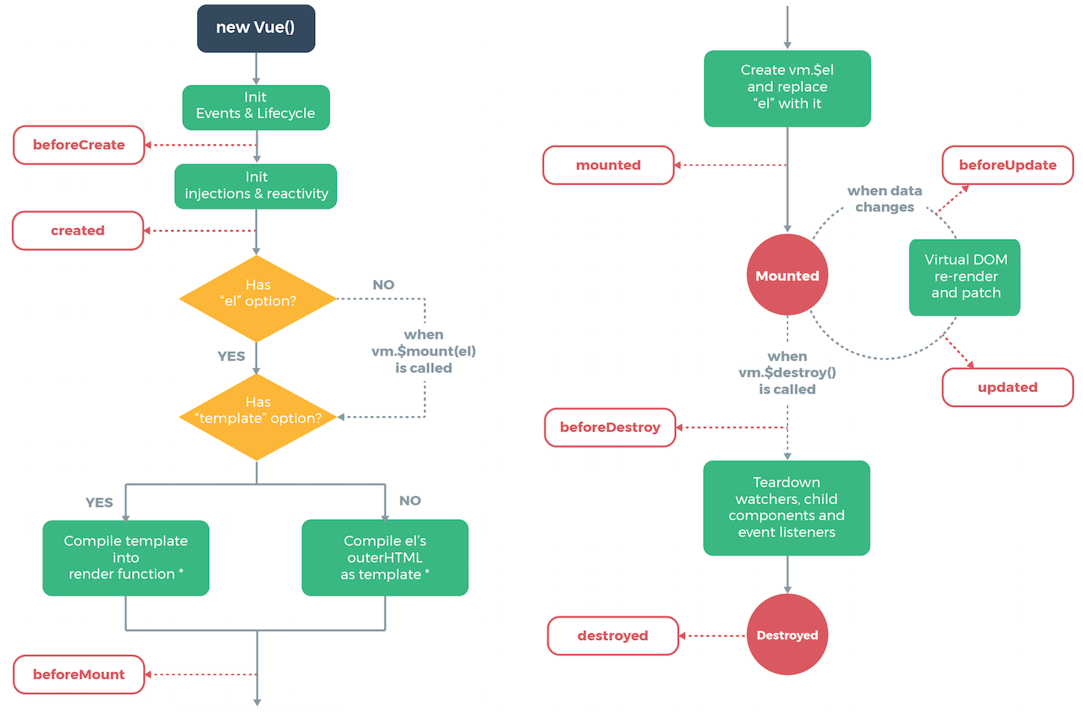

Slide 28
Vue component system
Vue component
Component communication
Single File Component

Slide 29
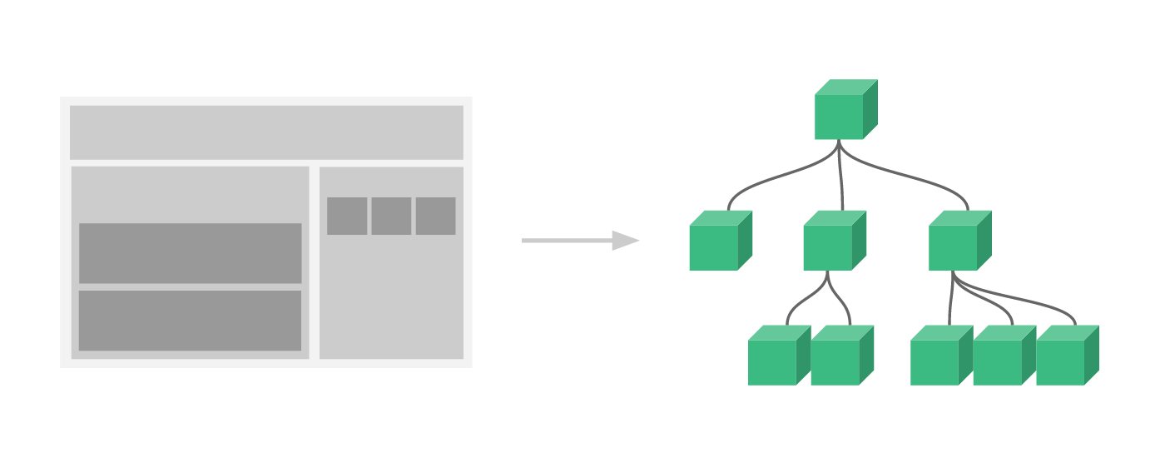
App root
App root
Header
Body
C
D
E
A
Header
Body
Drawer
Drawer
B
A
B
C
D
E

Slide 30
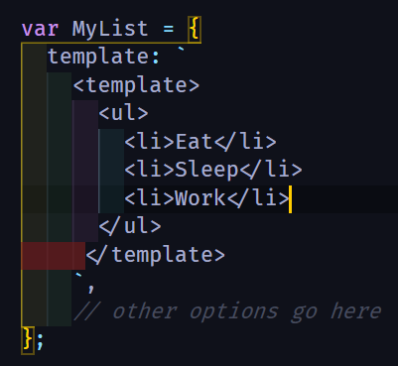

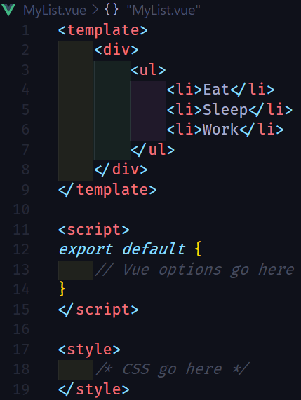

Component creation
Component registration
Literal Template
Local
Global
Usage
Single File Component

Slide 31
Components communication
Parent
Emit
Events
Pass Props
Child

Slide 32
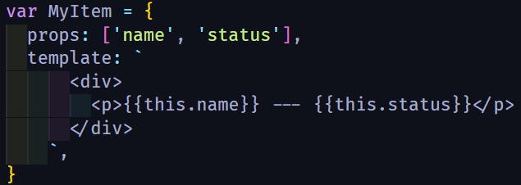
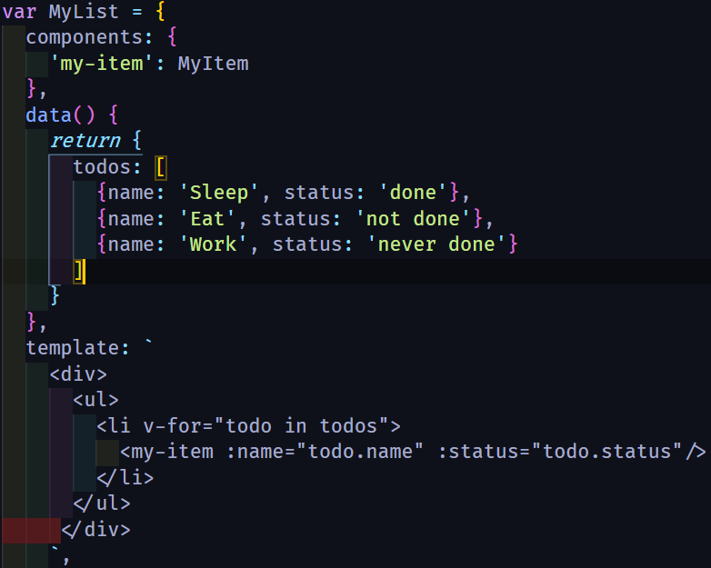
1. Define props inside child component
2. Pass data from parent to child
Parent
Pass Props
Child

Slide 33

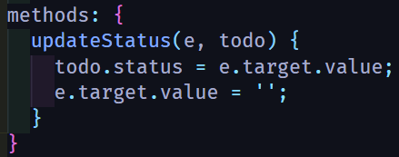
1. Define child component event
Parent
Child event name
2. Listen to child event
Emit
Events
Child

Slide 35
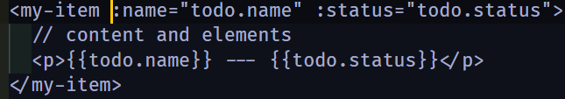
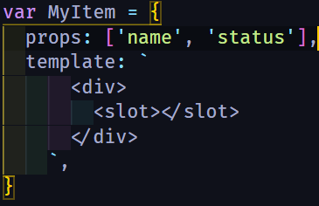
Slot element
How to pass content inside component tags ?
Slots can be separated by slot name
Parent can access child’s data via slot-scoped
Create generic component
Reduce the use of props

Slide 36
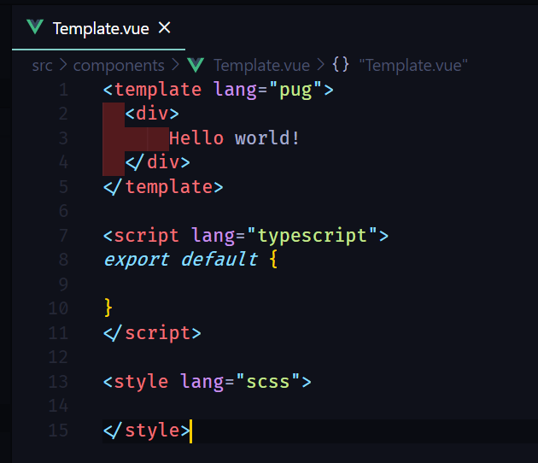

Single File Component (SFC)
Better syntax highlight
CommonJS modules
Codebase is more modularized
Component-scoped CSS
Project configuration is supported by Vue-CLI
Corporated with build system

Slide 37
The rest of Vue ecosystem
Vue router
Vuex
Build system: Vue CLI + vue-loader
Rendering process

Slide 38
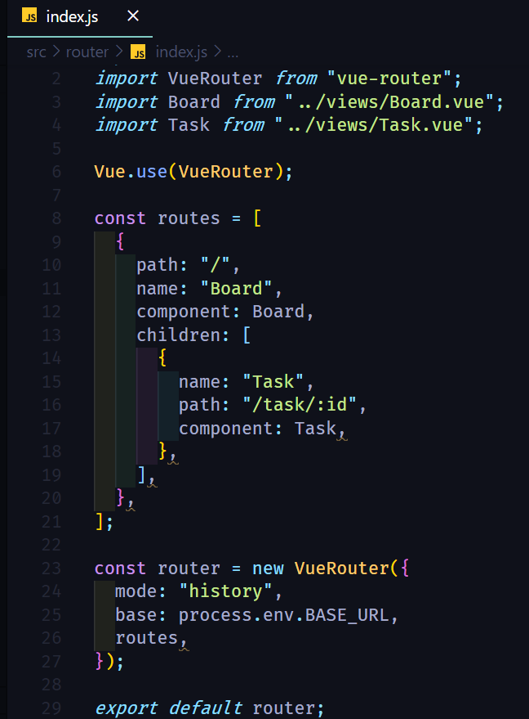
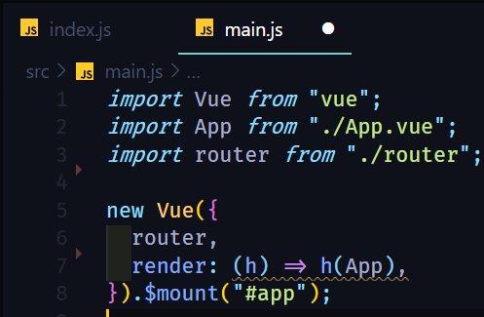
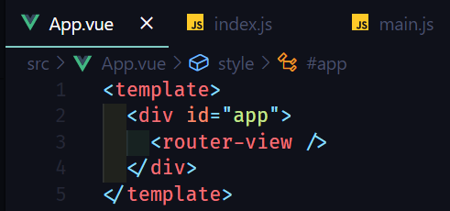
Vue router

Slide 39
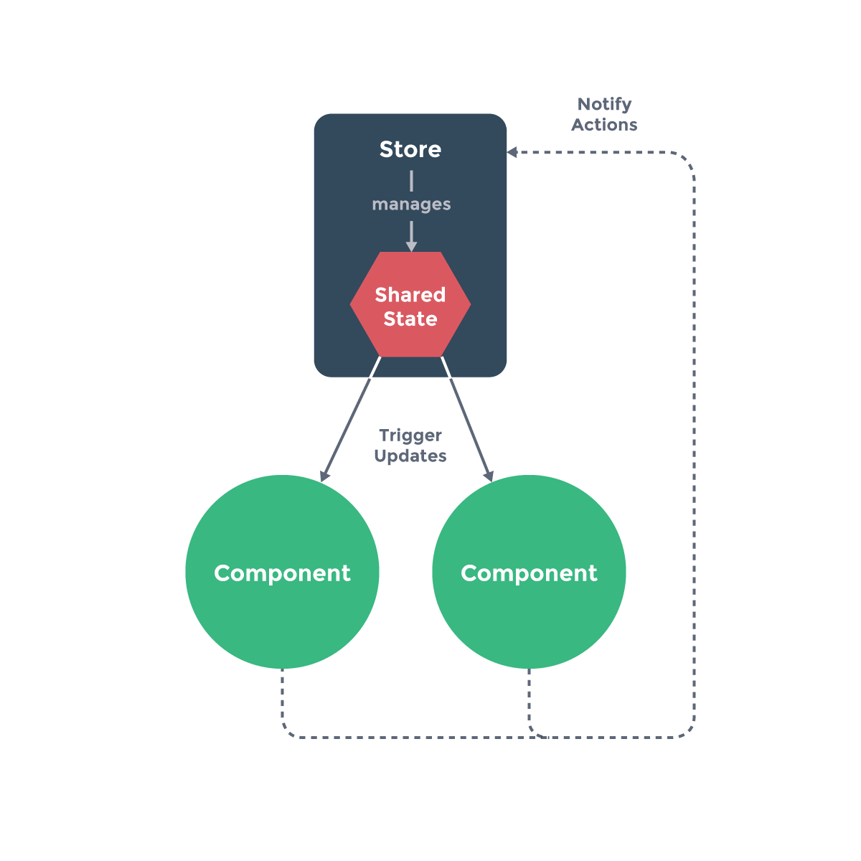
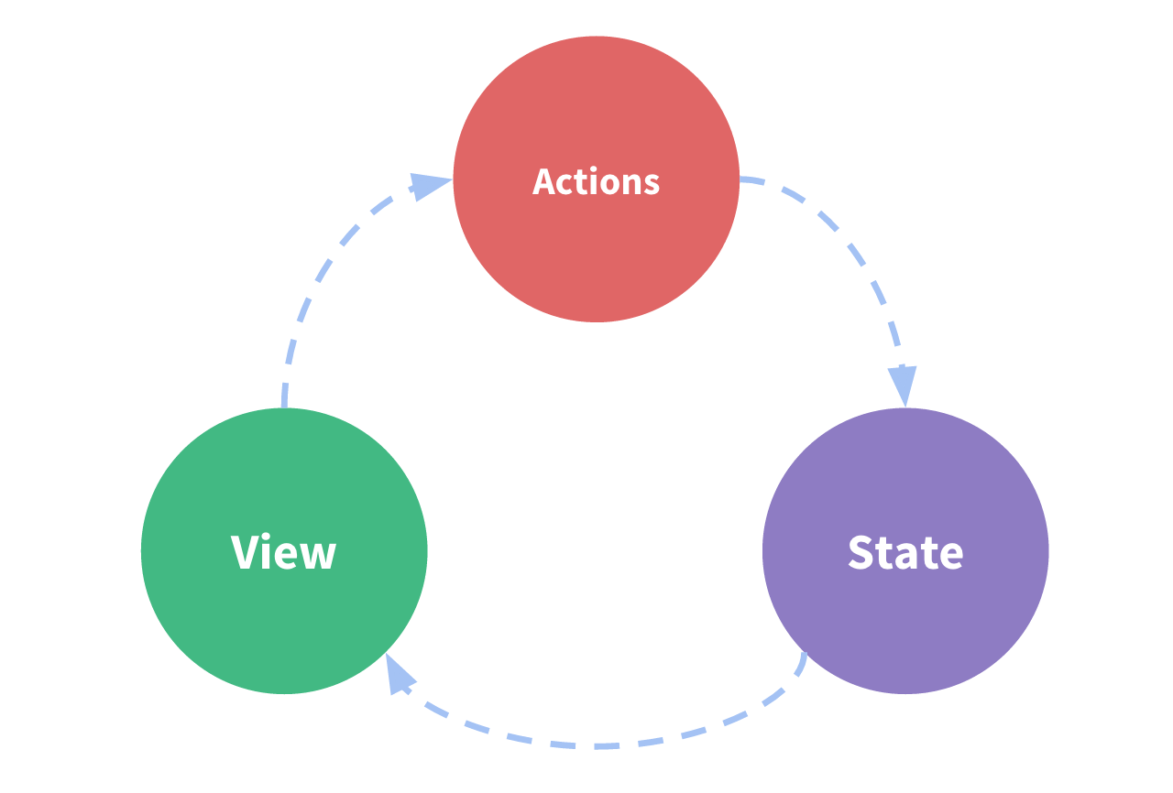
Vuex

Slide 40
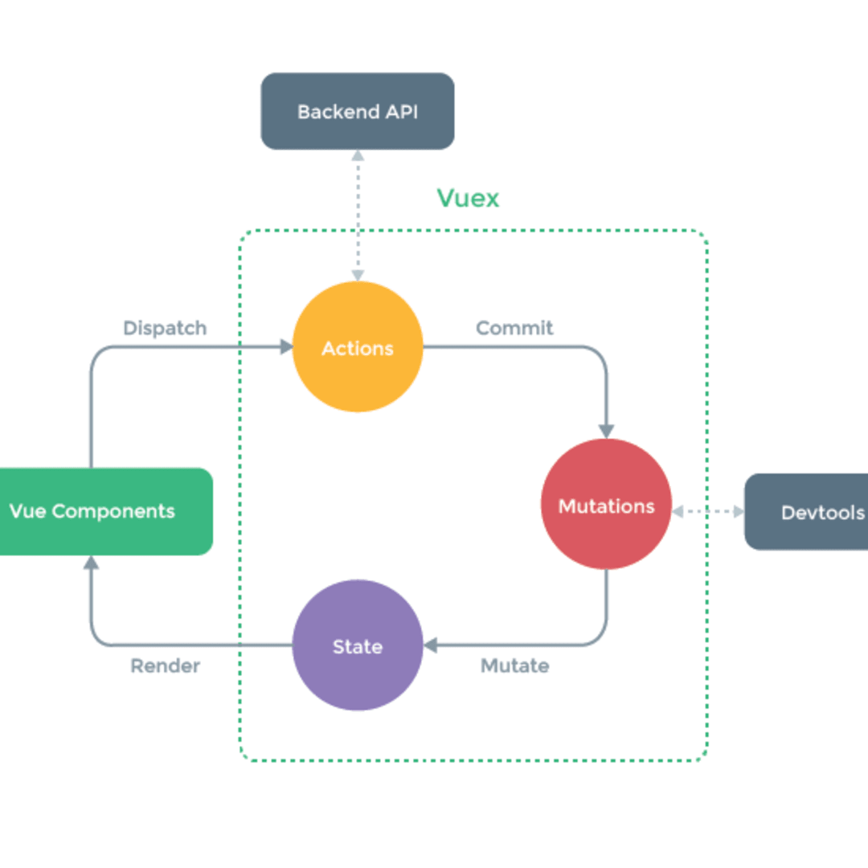
Vuex

Slide 41
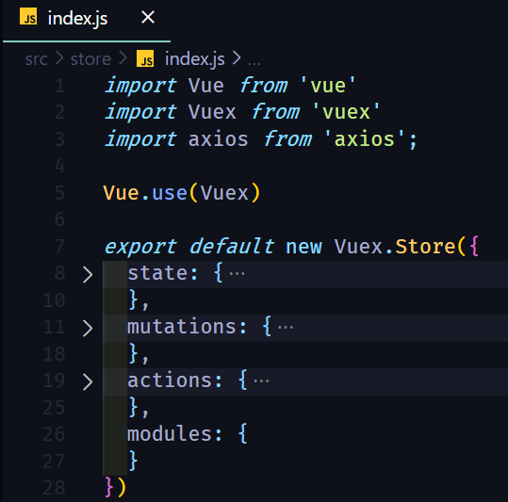
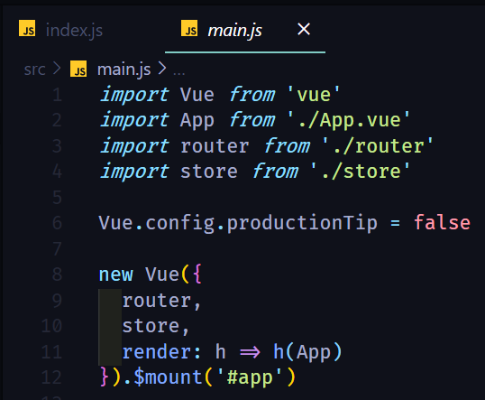
Vuex

Slide 42
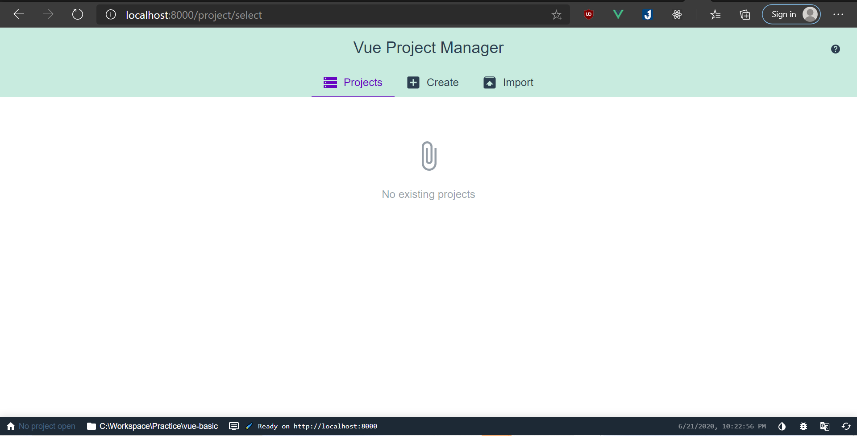
Vue CLI
CLI
CLI Service
CLI plugins
vue create <project_name>
vue serve
vue build
vue add
vue ui

Slide 43
vue-loader and vue-template-compiler
vue-template-compiler: Compiles Vue template into render functions
vue-loader: A webpack loader which helps user author SFC

Slide 44

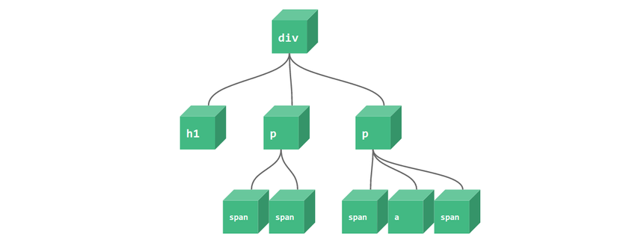
Vue rendering process
Vue Template
Render functions
VNodes
Real DOM
Virtual DOM
Pre-built

Slide 45
Live coding

Slide 46
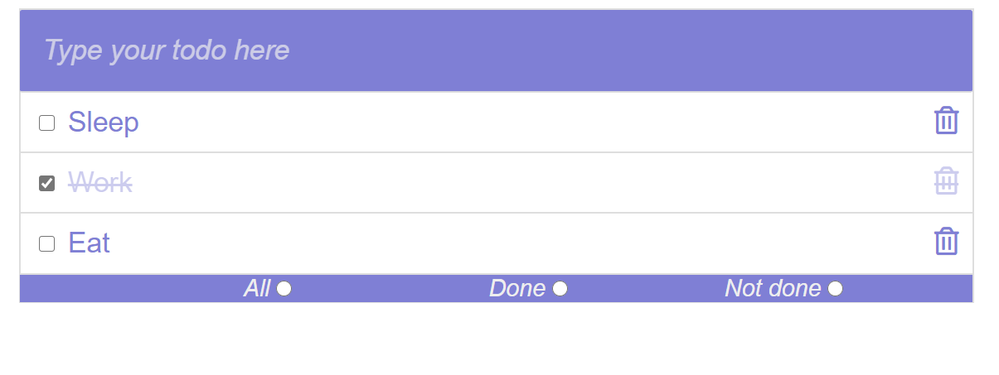
Todo app

Slide 47
Opinionated comparison

Slide 48
Compare with ReactJS
 | Vue | ReactJS
Reactive mechanism | Be specific on component | Use PureComponent to prevent re-render entire subtree components
Developing style | Easier for HTML-er | Easier for Javascript-er
Corporate libraries | Companion libraries like vue-router, vuex are officially supported by core team | React leaves these concern for community
Learning path | Easier for traditional web developer | Need to learn JSX and build systems

Slide 49
Comparison with Angular 2
 | Vue | Angular 2
Typescript based | No | Yes
Size | Smaller | Larger
Flexible | More | Less
Learning path | … | Steeper

Slide 50
The end!

